Slide 1

Multimedia Analysis and Retrieval
https://github.com/jonhare/COMP3013-MIAR
Jonathon Hare
jsh2@ecs.soton.ac.uk
powered by

Slide 2
Why analyse multimedia?

Slide 3
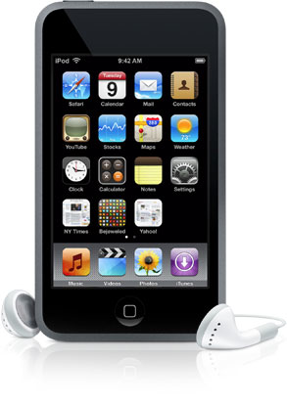
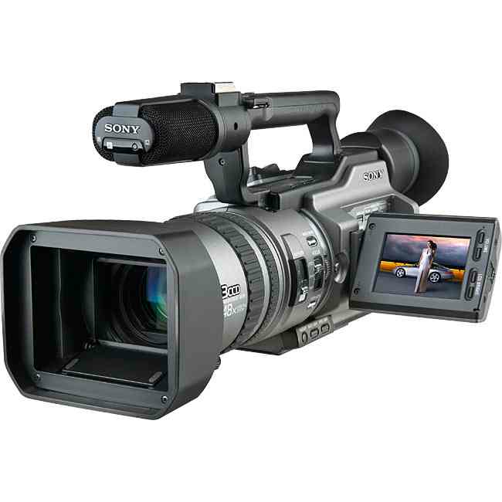
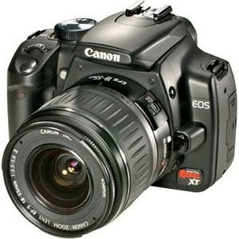



Multimedia is everywhere

Slide 4
Multimedia is everywhere
In 2012 flickr boasted hosting 7 Billion Photos

Slide 5
Multimedia is everywhere
Every minute 72 hours worth of video is uploaded to youtube

Slide 6
Multimedia is everywhere
As of October 2012 Spotify’s collection contains 18 million songs

Slide 7
Multimedia is everywhere
… that’s 170 years of music!

Slide 8
Analysis of this data can:
Help us find media that interests us
What sounds like this? Who looks like her? What is that?
Help us measure trends
What is popular now; what was popular then; what will be popular next?
Help us develop better compression techniques
…so we can store more data
Enable us to generate new media through re-composition
New artwork, augmented reality, virtual reality, …

Slide 9
Digital Multimedia Representation

Slide 10
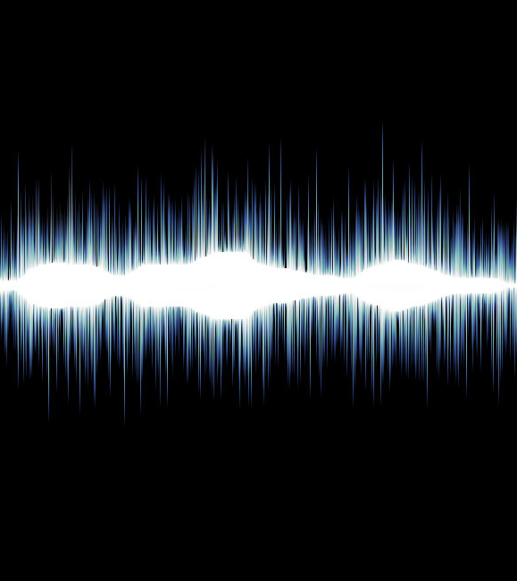
Digital Audio Representation
Digital sound is stored as a series of samples.
Each sample represents the loudness or sound pressure at an instance of time.

Slide 11
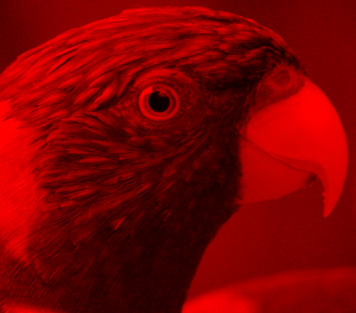
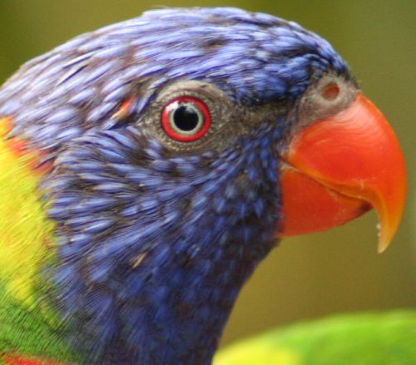
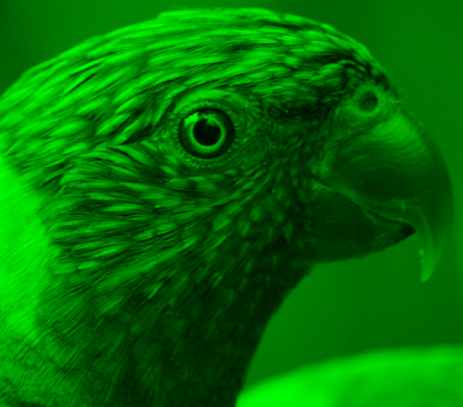
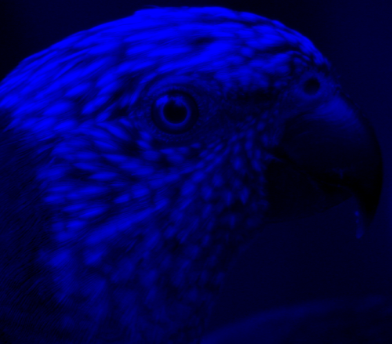
Digital Image Representation
87 91 85 ...
86 86 81 ...
88 85 84 ...
... ... ... ...
137 145 144 ...
153 150 137 ...
148 139 123 ...
... ... ... ...
89 91 89 ...
84 88 90 ...
88 87 90 ...
... ... ... ...

Slide 12






Digital Video Representation
Time

Slide 13
Retrieval

Slide 14
Multimedia Retrieval
Everyone of you is familiar with text retrieval
Google, Yahoo, Bing, …
Effective text retrieval has changed
…the way we work
…the way we learn
…the way we play
A current challenge is achieving effective retrieval of multimedia

Slide 15
Approaches to Multimedia Search
Traditional: index metadata & search on that
Content-based: search for similar things
Hybrid: use multimedia analysis to extract metadata from the content, then index & search on that

Slide 16
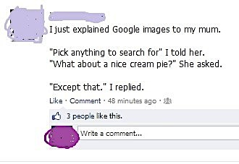
Traditional Search
Search on metadata is pretty much a solved problem…
Just be careful what you search for!
You need metadata…

Slide 17
Manual or Automatic?

Slide 18
Lets look at content-based retrieval in detail

Slide 19
What’s this music? Who performed it? When was it written?

Slide 20
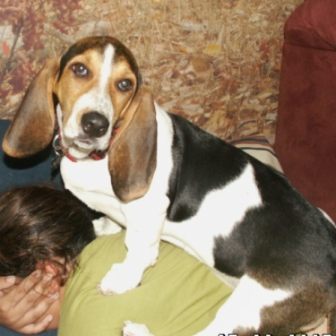
What is the name of this dog?

Slide 21






Slide 22
How does it work?

Slide 23
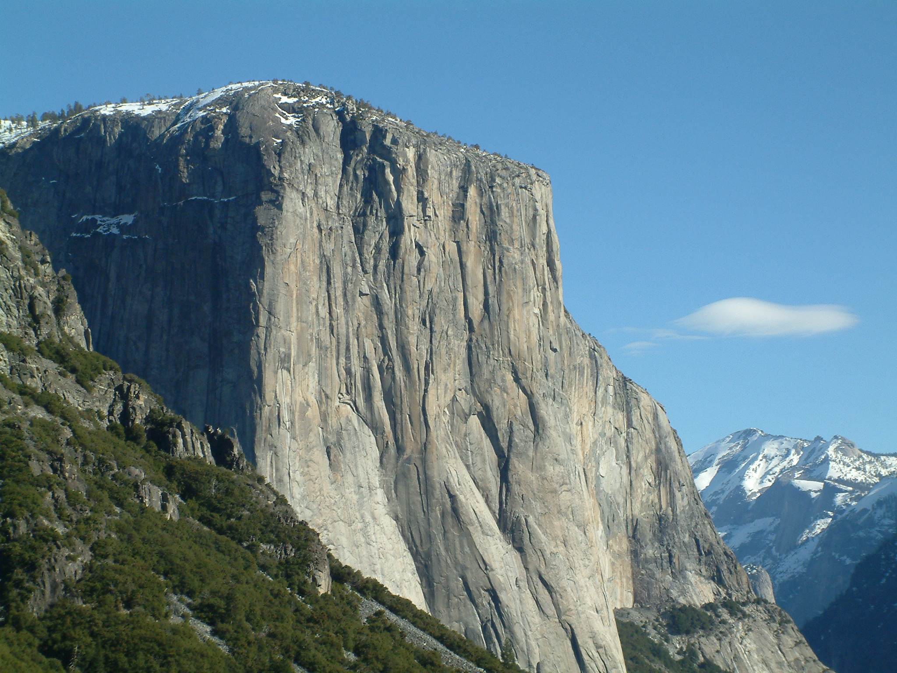
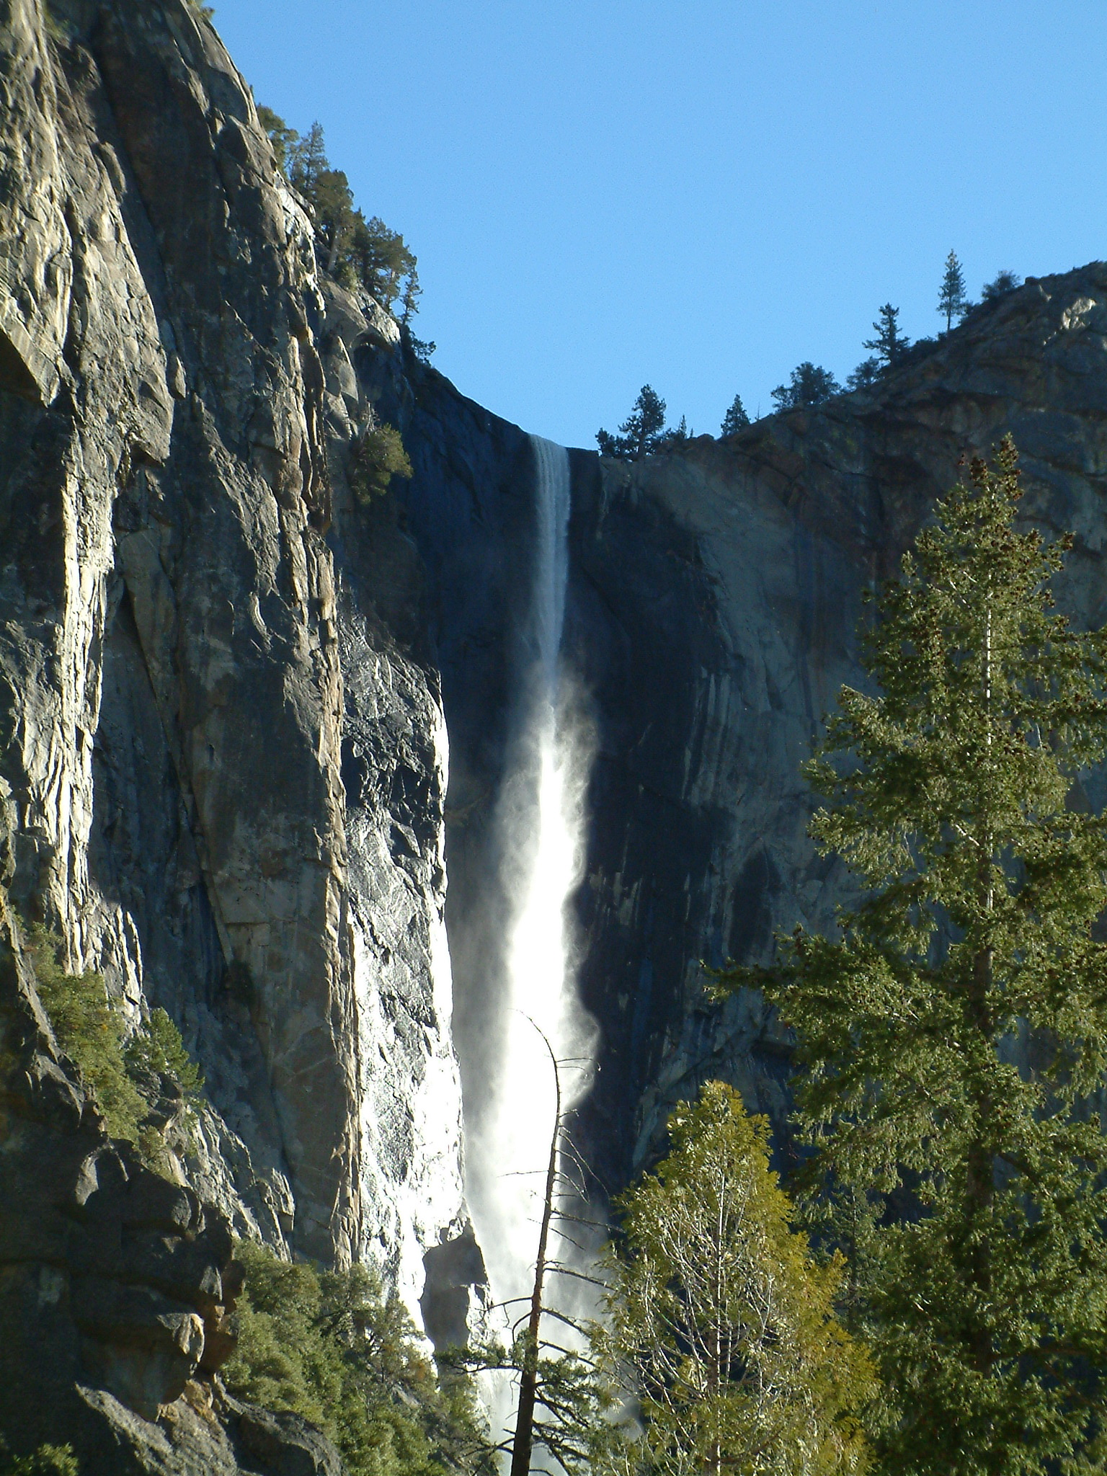
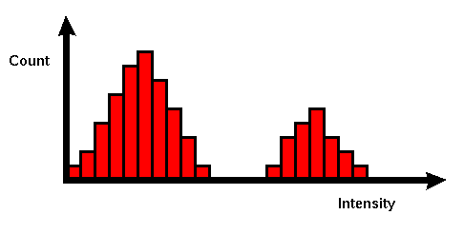
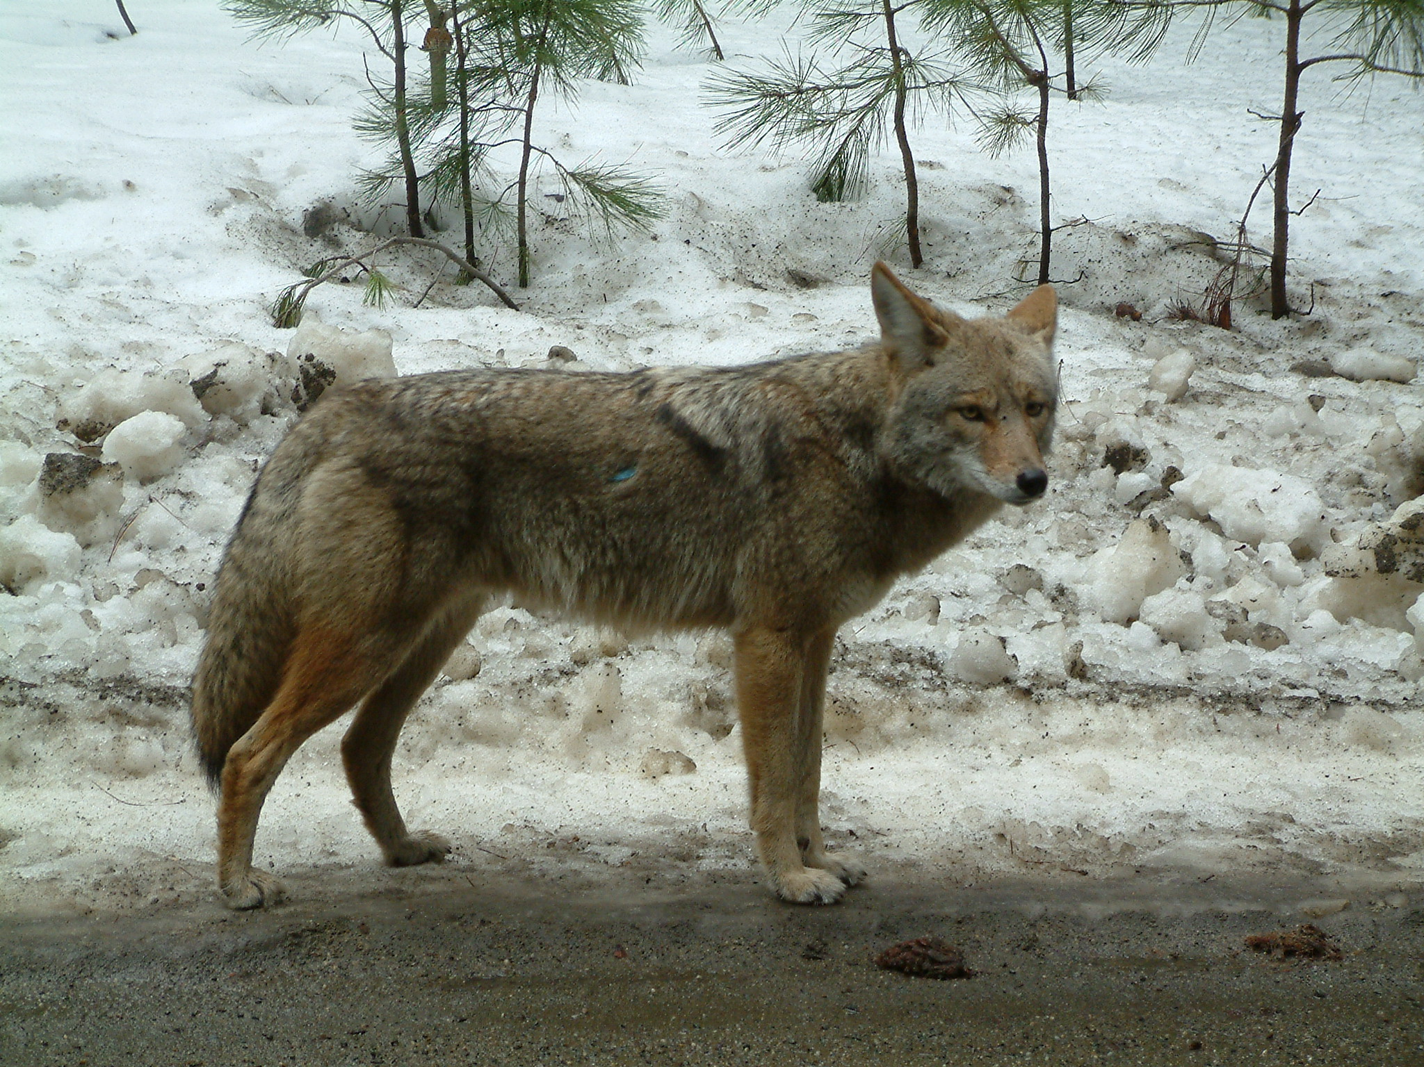
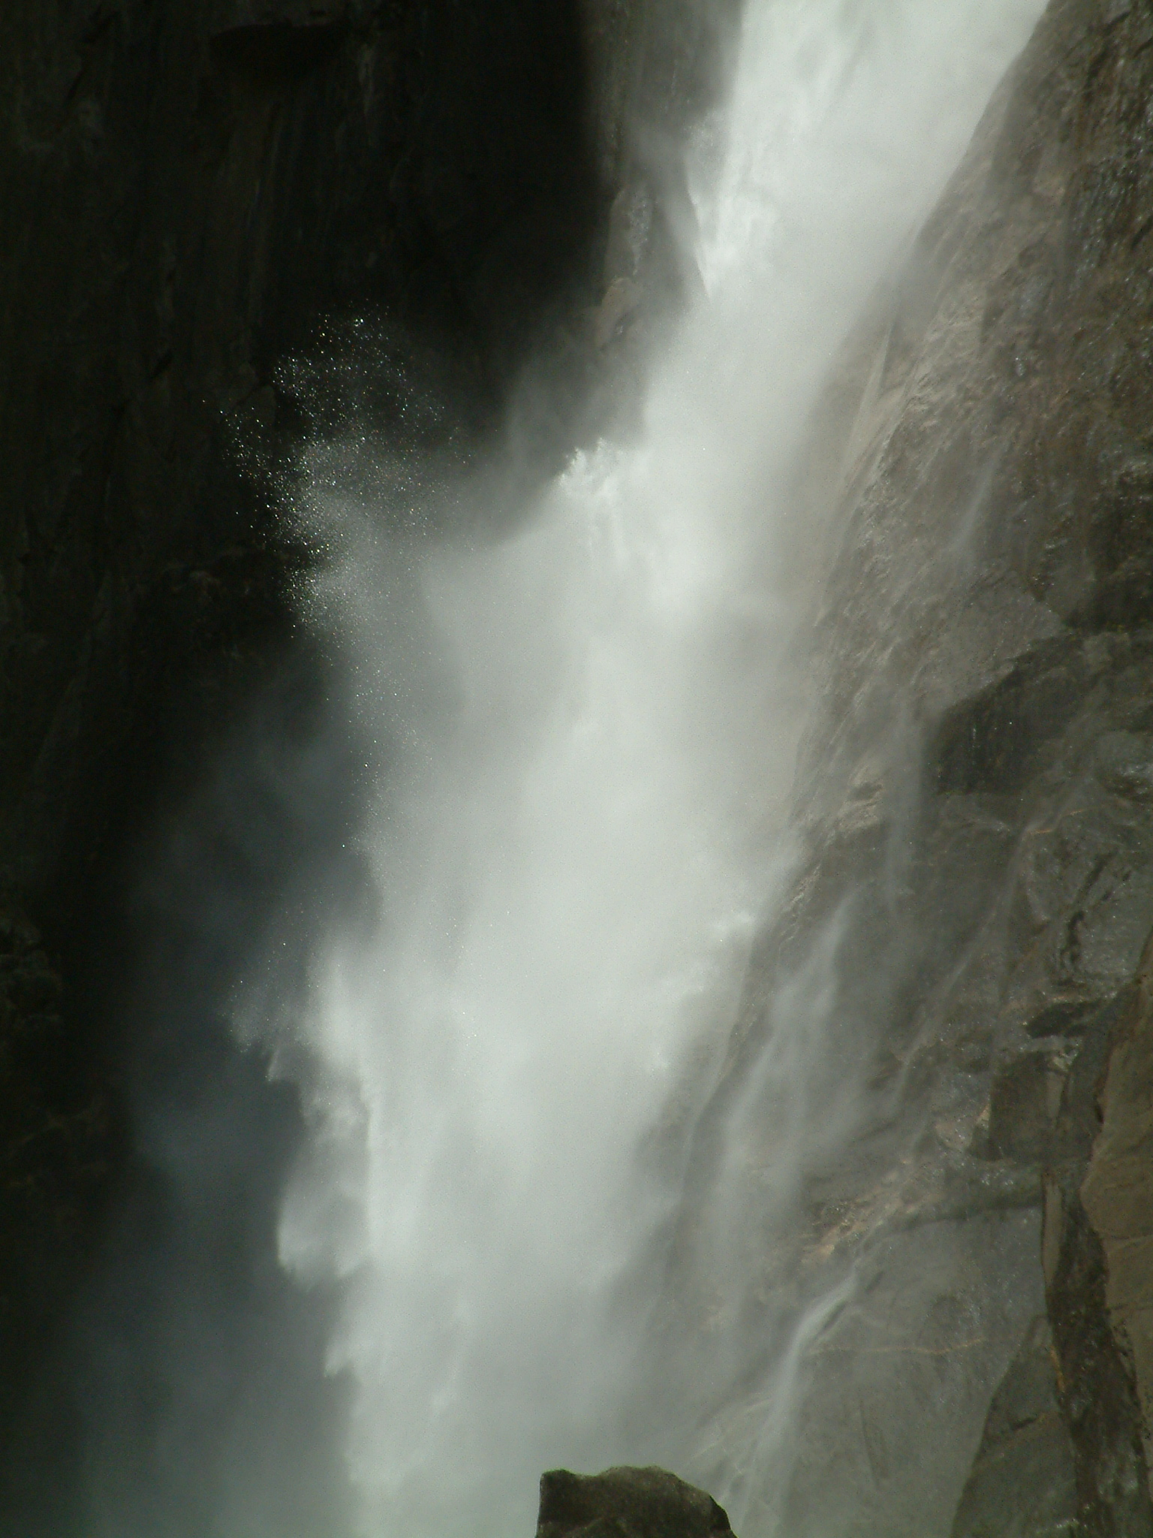
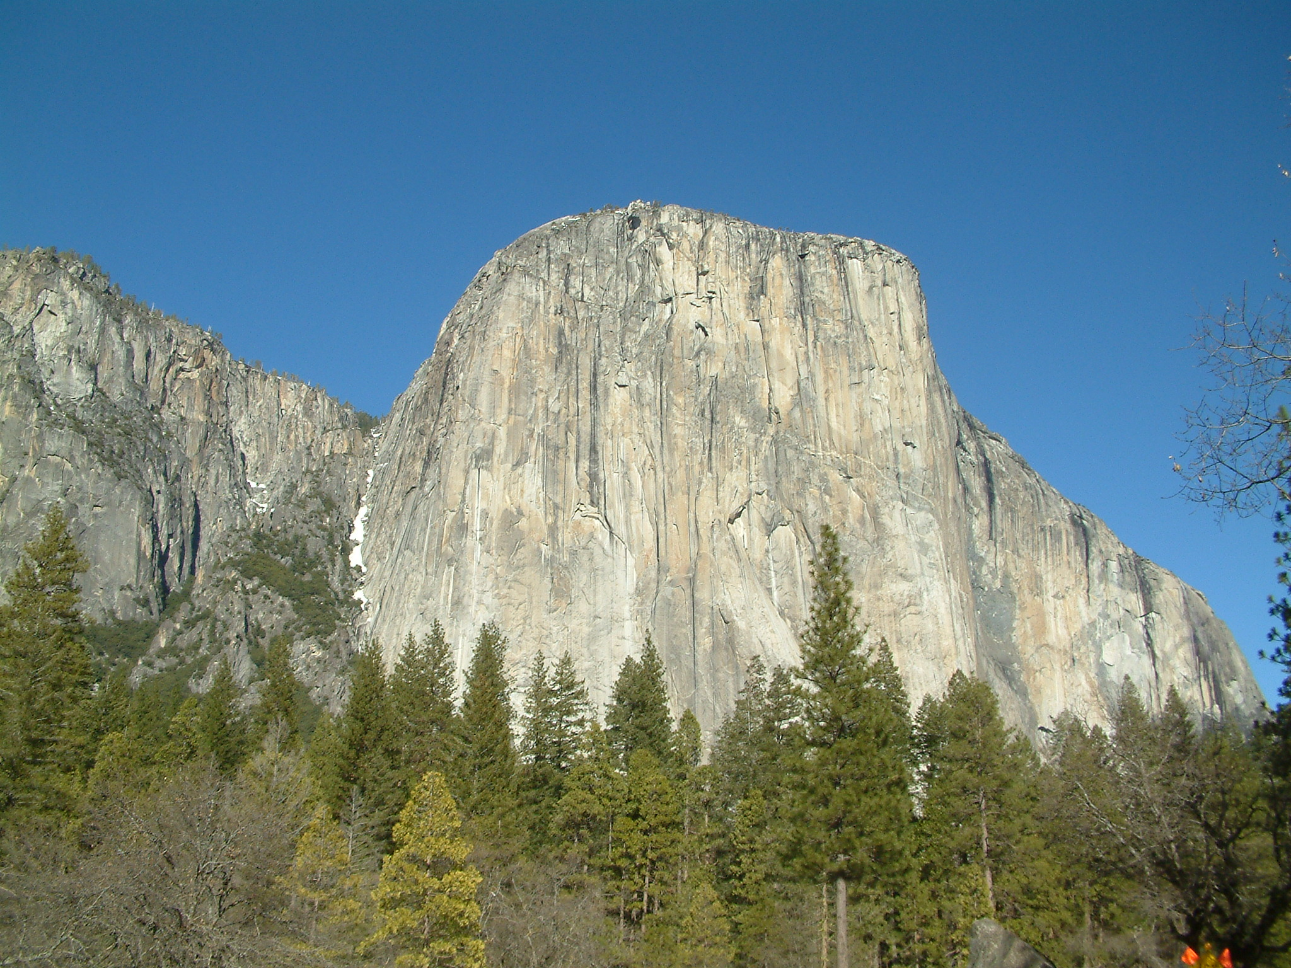
The Retrieval Pipeline
We extract a database of features from each media item in our corpus. To search we extract the same features from a query media item and compare its features to all of those extracted from the corpus.
Query
Search Engine
Result
Media Corpus
Database of features

Slide 24

Feature Extraction
f(x)
Feature extraction is the process of extracting “descriptors” from multimedia signals.
Descriptors describe some aspect of the media’s content.
Typically, a descriptor is a numerical vector called a “feature vector”, however other forms of descriptor are possible.

Slide 25
Example Image Features
colour histograms, segments and sift

Slide 26
Image Features: Global
Global features describe the content of an entire image
One of the simplest global features is the “Global RGB Colour Histogram”
Quantise each pixel into a discrete number of colours and then build a histogram.

Slide 27
Demo: Global Colour Features

Slide 28

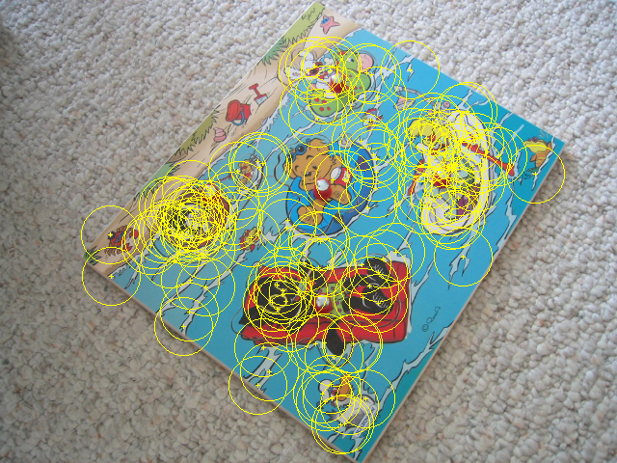
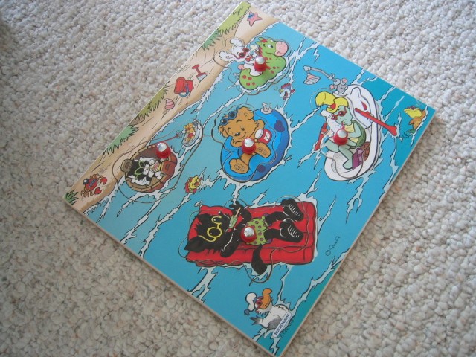
Image features: Local
Global features are useful for some tasks, but in many cases are not powerful enough
Local features attempt to overcome this by breaking the image into smaller parts from which to extract features
Three primary techniques for splitting up the image
segmentation
salient regions &
interest points
grids & blocks

Slide 29
Demo: Segmentation

Slide 30
Salient interest regions
Salient interest regions and their associated features are currently the most popular way of describing an image content.
Extracting image features using interest regions is a two-part process:
Find regions
Extract feature to describe region properties
Typically, the resultant image feature will have a variable length, dependent on the number of regions

Slide 31
Salient interest region location
Important regions portray:
Repeatability
Saliency
Corners and blobs have these qualities
Detectable using various techniques
Difference of Gaussian - corners
Harris corner detector - corners
MSER - blobs
corners
blobs

Slide 32
Demo: DoG

Slide 33
Salient interest region descriptors
Good region descriptors portray:
Resilience to image transforms
Compactness
Emphasise different image characteristics:
Pixel intensities, colour, texture, edges etc.
Common descriptors include:
SIFT: histogram of edge orientation
Shape context: histogram of edge location

Slide 34
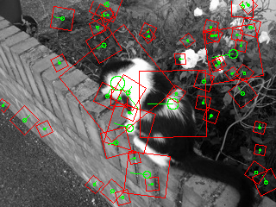
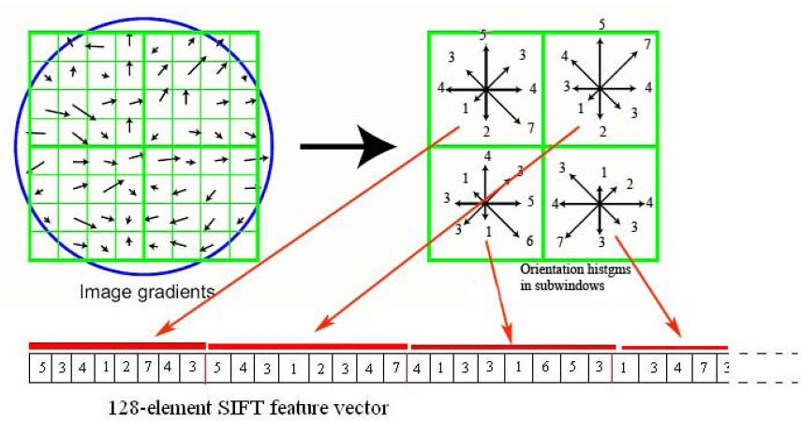
SIFT: Scale Invariant Feature Transform

Slide 35
Demo: SIFT Matching

Slide 36
Analogies with text
introducing the visual bag-of-words

Slide 37
Bags of Visual Words
In the computer vision community over recent years it has become popular to model the content of an image in a similar way to a “bag-of-terms” in textual document analysis.

Slide 38
BoVW using local features
Features localised by a robust region detector and described by a local descriptor such as SIFT.
A vocabulary of exemplar feature-vectors is learnt.
Traditionally through k-means clustering.
Local descriptors can then be quantised to discrete visual terms by finding the closest exemplar in the vocabulary.

Slide 39
Demo: SIFT Bag of Words

Slide 40
What about Video?
Simplest way to extract features from video is to treat each frame as a separate image.
There is a lot of redundancy
Can be better to find keyframes from each “shot”

Slide 41
Demo: Shot Keyframe Detection

Slide 42
What about Audio?
It turns out that one (good) way to extract features from audio is to transform it into an image first!
The image representation is a “spectrogram”
This is how Shazam works….

Slide 43
Demo: Audio Spectrogram

Slide 44
Any Questions?

